Slide 1
EXPLORING THE USE OF MACHINE LEARNING FOR IMAGE AUTHENTICATION

Slide 2
INTRODUCTION
The use of generative models in image creation is a powerful tool, but it has also introduced new challenges in image analysis and identification.
With the increasing use of AI-generated images, there is a growing concern about their authenticity and potential for malicious use.
It is becoming increasingly difficult to distinguish between real and AI-generated images, which can have significant implications for fields such as journalism, forensics, and security.
Machine learning algorithms can be used to analyze the patterns and features of images to distinguish between real and AI-generated images.
Developing a reliable and accurate method for detecting AI-generated images is critical to address these concerns.

Slide 3
PROBLEM STATEMENT
The problem is to develop a reliable and accurate method for detecting AI-generated images in the presence of sophisticated techniques, which have implications for fields such as journalism, forensics, and security.

Slide 4
KEY FEATURES IN IDENTIFYING FAKE IMAGES
Unnatural looking objects or people
Inconsistent shadows or lighting
Unnatural colors
Inconsistent image composition
Inconsistent image quality

Slide 5
POSSIBLE SOLUTIONS
Supervised learning: Model learns to recognize features and patterns that distinguish between the two types of images.
Unsupervised learning: Use unsupervised algorithms to cluster images based on similarities in their features.
Adversarial training: The model is trained on a mix of clean and adversarial examples, and the adversarial examples are generated during the training process. This helps the model learn to recognize and handle adversarial inputs, making it more robust in real-world scenarios.
Transfer learning: Use pre-trained models like VGG or ResNet to extract image features.

Slide 6
TRANSFER LEARNING
Transfer learning is a technique used in machine learning where a pre-trained model is used as a starting point for a new task. In the context of identifying AI-generated images, transfer learning can be used to leverage the features learned by a pre-trained model on a large dataset of images.

Slide 7
ADVERSARIAL TRAINING
Adversarial training can require significant computation power.
Adversarial training involves repeatedly generating and training on adversarial examples, which are inputs that have been intentionally designed to fool the model.
Adversarial training process involves adding additional layers or modifying the architecture of the model, this can also increase the computational requirements.

Slide 8
GENERATIVE ADVERSARIAL NETWORK
Two neural networks are trained together in an adversarial manner: a generator network and a discriminator network.
Generator network generates new data that is similar to a set of training data.
The discriminator network tries to distinguish between the real training data and the fake data generated by the generator.
The discriminator network learns to identify specific features that are present in the training images but not in the generated images.
This process requires a high amount of computational power due to the complexity of the GAN architecture and the large amount of data involved.
The training process can take a long time and may require the use of specialized hardware such as GPUs or TPUs.
https://arxiv.org/pdf/1710.07035.pdf

Slide 9
MAJOR MILESTONES
Dataset collection and pre-processing.
Choose a model and open source platform.
Train a model.
Fine-tune the model.
Evaluate the model.
Build UI

Slide 10
DATASET: CIFAKE
The dataset consist of 1970 fake and 1970 real images.
The “FAKE” class is 0 and the “REAL” class is 1.
The data is split into train test split in 0.2 ratio.
https://arxiv.org/pdf/2303.14126.pdf

Slide 11

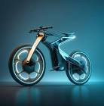
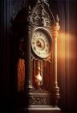
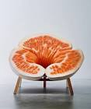
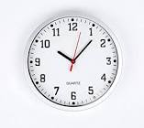
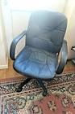
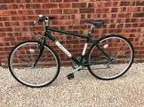
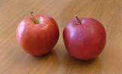
DATASET
AI GENERATED IMAGES:
REAL IMAGES:

Slide 12
MODELS
CNN: Consisting of 3-5 layers including convolutional layers and fully connected layers.
VGG16 Architecture: Consists of 16 layers, including 13 convolutional layers and 3 fully connected layers.
LeNet Architecture: Consists of 7 layers, including 2 convolutional layers, 2 subsampling layers, and 3 fully connected layers.
Resnet Architecture: In this network, we use a technique called skip connections. The skip connection connects activations of a layer to further layers by skipping some layers in between. This forms a residual block. Resnets are made by stacking these residual blocks together.

Slide 13
TENSORFLOW
TensorFlow is a free and open-source software library for machine learning and artificial intelligence.
TensorFlow's APIs use Keras to allow users to make their own machine learning models.
Build and train state-of-the-art models without sacrificing speed or performance.
TensorFlow gives you the flexibility and control with features like the Keras Functional API and Model Subclassing API for creation of complex topologies.

Slide 14
IMPORTANT HYPER PARAMETERS:
Number of convolutional layers
Number of filters in each convolutional layer
Size of the filters in each convolutional layer
Stride size for each convolutional layer
Pooling method and size for each pooling layer
Activation function for each layer
Learning rate
Batch size
Number of epochs

Slide 15
IMPORTANT HYPER PARAMETERS:
The number of convolutional layers and filters determines the complexity of the CNN and its ability to capture important features in the images.
The filter size and stride size determine the level of detail the CNN can capture in each convolutional layer.
The pooling method and size reduce the dimensionality of the feature maps, while maintaining important information.
The activation function introduces non-linearity into the CNN, allowing it to learn complex relationships between the features.
The learning rate controls the size of the step taken during the optimization process, affecting the speed and accuracy of the CNN.
The batch size determines how many samples are used in each iteration of training.
The number of epochs determines the number of times the entire dataset is passed through the CNN during training.
NOTE: Regularization techniques, such as dropout and weight decay, can also be used to improve the performance of the CNN.

Slide 16
CONVOLUSION NEURAL NETWORK:
Convolutional layer with 80 filters, kernel size (3, 3), and ReLU activation.
MaxPooling layer with pool size (2, 2).
Dropout layer with a rate of 0.5.
Convolutional layer with 40 filters, kernel size (3, 3), and ReLU activation.
MaxPooling layer with pool size (2, 2).
Dropout layer with a rate of 0.5.
Convolutional layer with 20 filters, kernel size (3, 3), and ReLU activation.
MaxPooling layer with pool size (2, 2).
Dropout layer with a rate of 0.5.
Flatten layer to convert the output into a 1D vector.
Fully connected layer with 128 units and ReLU activation.
Fully connected layer with the number of classes and softmax activation.

Slide 17
DEEPFAKE
Deepfake Image Detection Parameters:
Facial Alignment: Analyse facial features for misalignments or unnatural movements.
Skin Texture and Color: Identify inconsistencies in skin texture, color variations, or artifacts.
Lighting and Shadows: Deepfake images may have inconsistencies in lighting and shadows, especially if the source and target images have different lighting conditions.
Reflections and Highlights: Deepfake images may fail to accurately capture reflections or highlights on the face, leading to discrepancies.
Hair and Hairstyle: Deepfake algorithms may struggle to accurately replicate complex hair patterns or styles.
Image Quality: Flag images with variations in quality, noise, or compression artifacts.

Slide 18
OPENCV FOR REASONING
OpenCV provides powerful image processing and computer vision functions that can be used to analyze visual features and characteristics of deep fake images.
OpenCV includes methods for detecting image blurriness, analyzing noise patterns, and identifying compression artifacts, which can serve as indicators of deep fake manipulation.
By applying image forensics techniques using OpenCV, such as error level analysis or visual consistency analysis, potential signs of deep fake manipulation can be identified and reasoned for classification purposes.

Slide 19
PARAMETERS USED IN OPENCV
The Laplacian variance parameter assesses the level of sharpness or focus in the image. A lower value indicates possible blurriness or tampering.
Entropy provides an indication of the image's information content and randomness. A higher entropy value suggests a more intricate and natural image.
Mean gradient calculates the average intensity or color change among neighboring pixels. A higher mean gradient value signifies greater presence of edges or texture details in the image.
Color consistency evaluates the uniformity of colors throughout the image. A lower value suggests potential color variations or alterations.
Light misalignment detects irregularities in lighting across the image. A higher value indicates potential issues with lighting conditions or image manipulations.

Slide 20
REASONING PARAMETERS
Laplacian Variance:
What it measures: This parameter assesses how clear and focused the image appears.
High value: A high value indicates that the image is sharp and well-focused, with clear details and crisp edges. It suggests that the image has a high level of clarity.
Low value: A low value suggests possible blurriness or tampering in the image. It indicates that the image may lack sharpness and appear blurry or out of focus. A low value could also indicate that the image has been intentionally tampered with or altered.
Threshold: If the calculated value is below 100, it indicates potential blurriness or tampering.

Slide 21
Entropy:
What it measures: Entropy indicates how much information and randomness there is in the image.
High value: A higher entropy value suggests a more intricate and natural image with a lot of details and diverse patterns. It indicates that the image contains a significant amount of information and randomness, making it visually complex and rich in content.
Low value: A low entropy value indicates a less complex and less information-rich image. It suggests that the image may have repetitive patterns or uniform areas, with less visual diversity or randomness.
Threshold: If the calculated entropy value is above 3.5, it suggests a complex and information-rich image.

Slide 22
Mean Gradient:
What it measures: Mean Gradient calculates the average intensity or color change between neighboring pixels.
High value: A higher mean gradient value signifies a greater presence of edges or texture details in the image. It indicates that the image has strong and prominent edges or pronounced variations in color or intensity between neighboring pixels.
Low value: A low mean gradient value suggests a smoother image with fewer visible edges or texture details. It indicates a more uniform and less textured appearance in the image.
Threshold: If the calculated value exceeds 25, it suggests the image has prominent edges or texture details.

Slide 23
Color Consistency:
What it measures: Color Consistency evaluates how consistent the colors are throughout the image.
High value: A higher color consistency value suggests that the colors in the image are uniform and consistent throughout. It indicates that the image has a balanced and consistent color distribution, without significant variations or alterations.
Low value: A lower color consistency value suggests potential color variations or alterations in different areas of the image. It indicates that the image may have inconsistencies in color representation, such as color shifts or variations in different regions.
Threshold: If the calculated value falls below 50, it indicates possible color variations or inconsistencies.

Slide 24
Light Misalignment:
What it measures: Light Misalignment detects irregularities in lighting conditions across the image.
High value: A higher value indicates potential issues with lighting conditions or image manipulations. It suggests that the image may have uneven lighting across different areas, possibly due to lighting artifacts, shadows, or intentional alterations.
Low value: A low light misalignment value suggests more consistent and even lighting conditions across the image. It indicates that the lighting is uniform and well-balanced, without significant irregularities or variations.
Threshold: If the calculated value exceeds 30, it suggests the presence of lighting irregularities or possible image manipulations.

Slide 25
ARCHITECTURE AND THEIR ACCURACY
Architecture | Model Loss | Model Accuracy
VGG | 1.6827 | 0.8480
VGG+CNN | 7.5508 | 0.8807
LeNet | 4.7588 | 0.5838
ResNet | 5.5291 | 0.6434
Densenet | 2.5932 | 0.6472

Slide 26
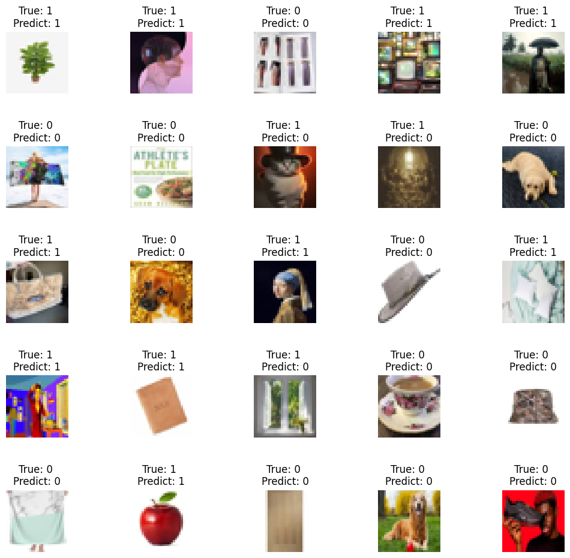
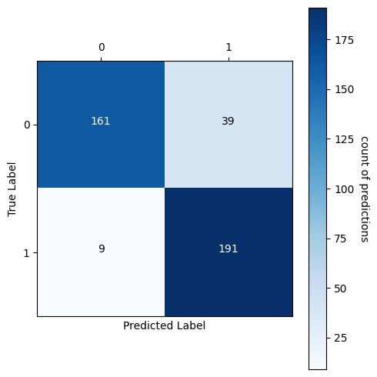
PREDICTIONS
Transfer learning : VGG to CNN

Slide 27
STREAMLIT
Streamlit is a Python library that simplifies the development of interactive web applications, allowing you to build user interfaces using Python code.
Can seamlessly integrate an image classification model by loading the model, preprocessing input images, and performing inference to obtain predictions.
The results of the image classification can be displayed using Streamlit's interactive components, such as text, tables, and plots, providing a user-friendly presentation of the predictions.
Streamlit enables user interaction by allowing them to upload images for classification, adjust parameters, and view additional information, with the UI automatically updating in response.
Once the UI is built, Streamlit makes it easy to deploy the application on various platforms, including local servers, cloud services, or as standalone executables.

Slide 28
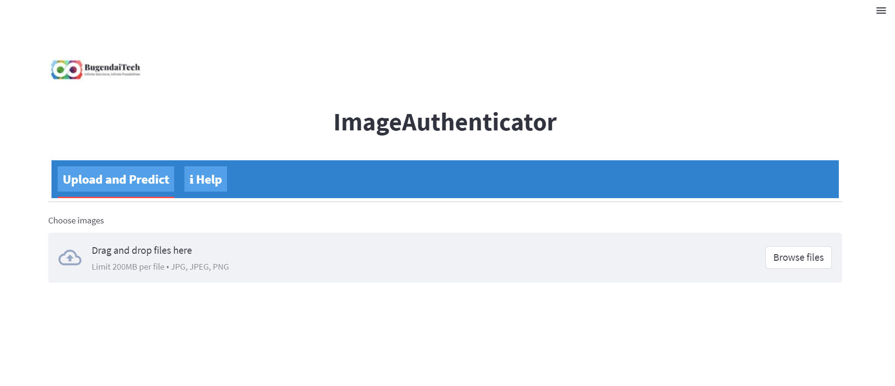
STREAMLIT

Slide 29
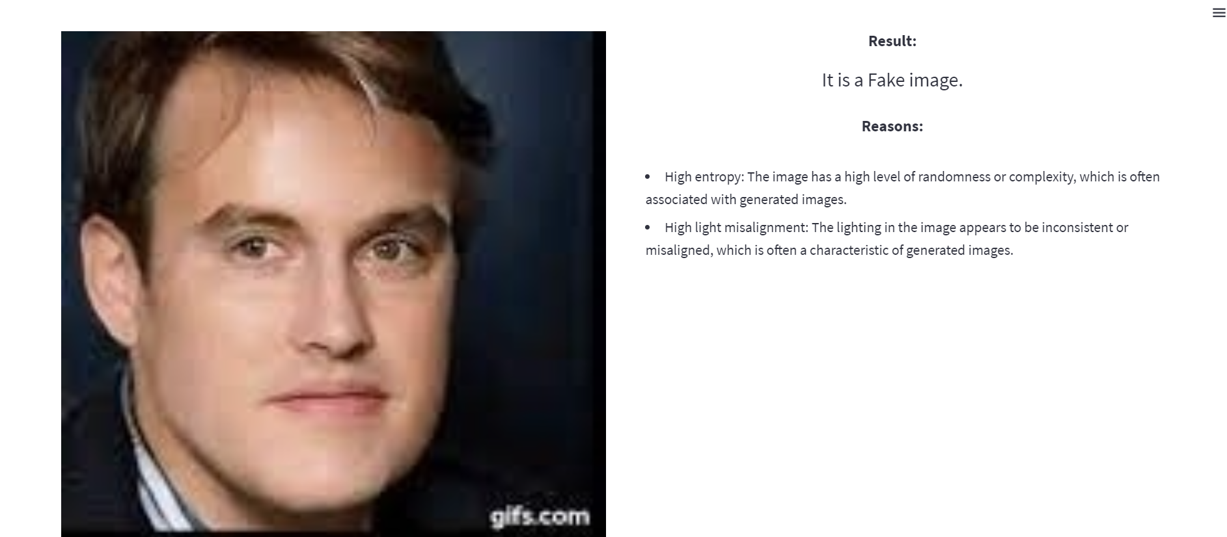
FAKE IMAGE REASONING

Slide 30
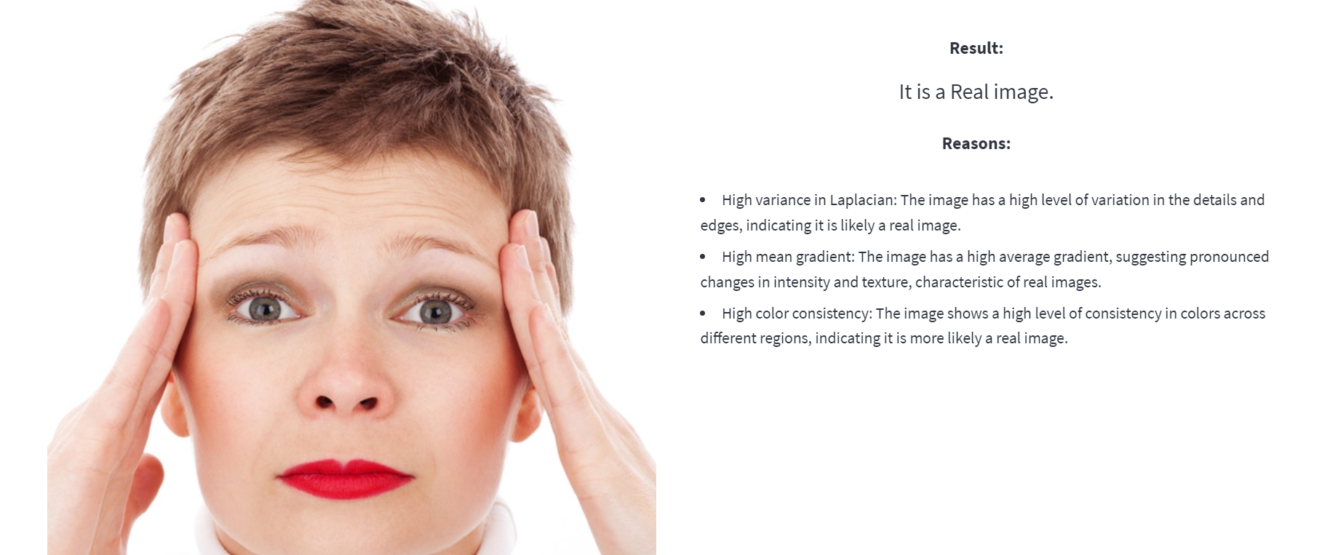
REAL IMAGE REASONING

Slide 31
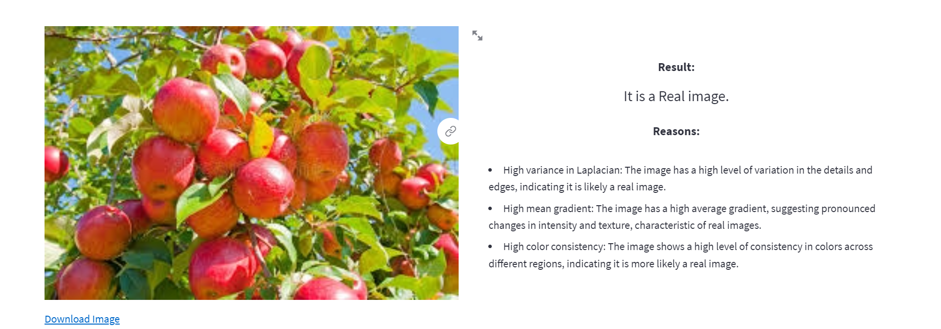
PREDICTION RESULTS
Uploading a single image

Slide 32
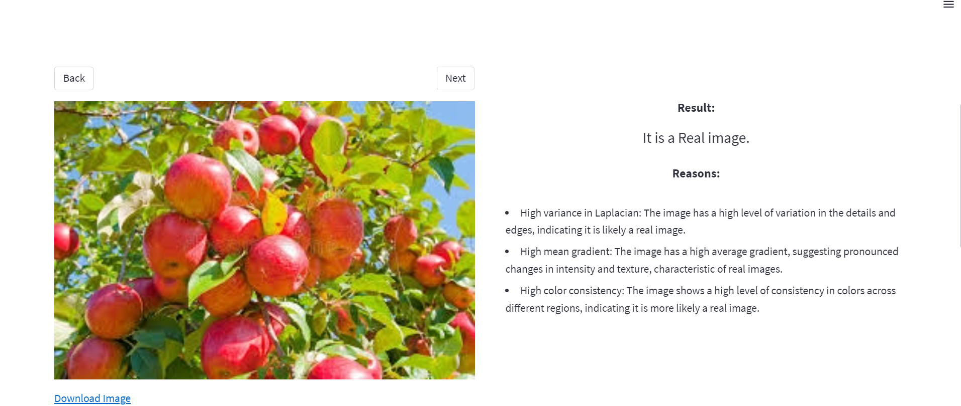
PREDICTION RESULTS
Uploading multiple images

Slide 33
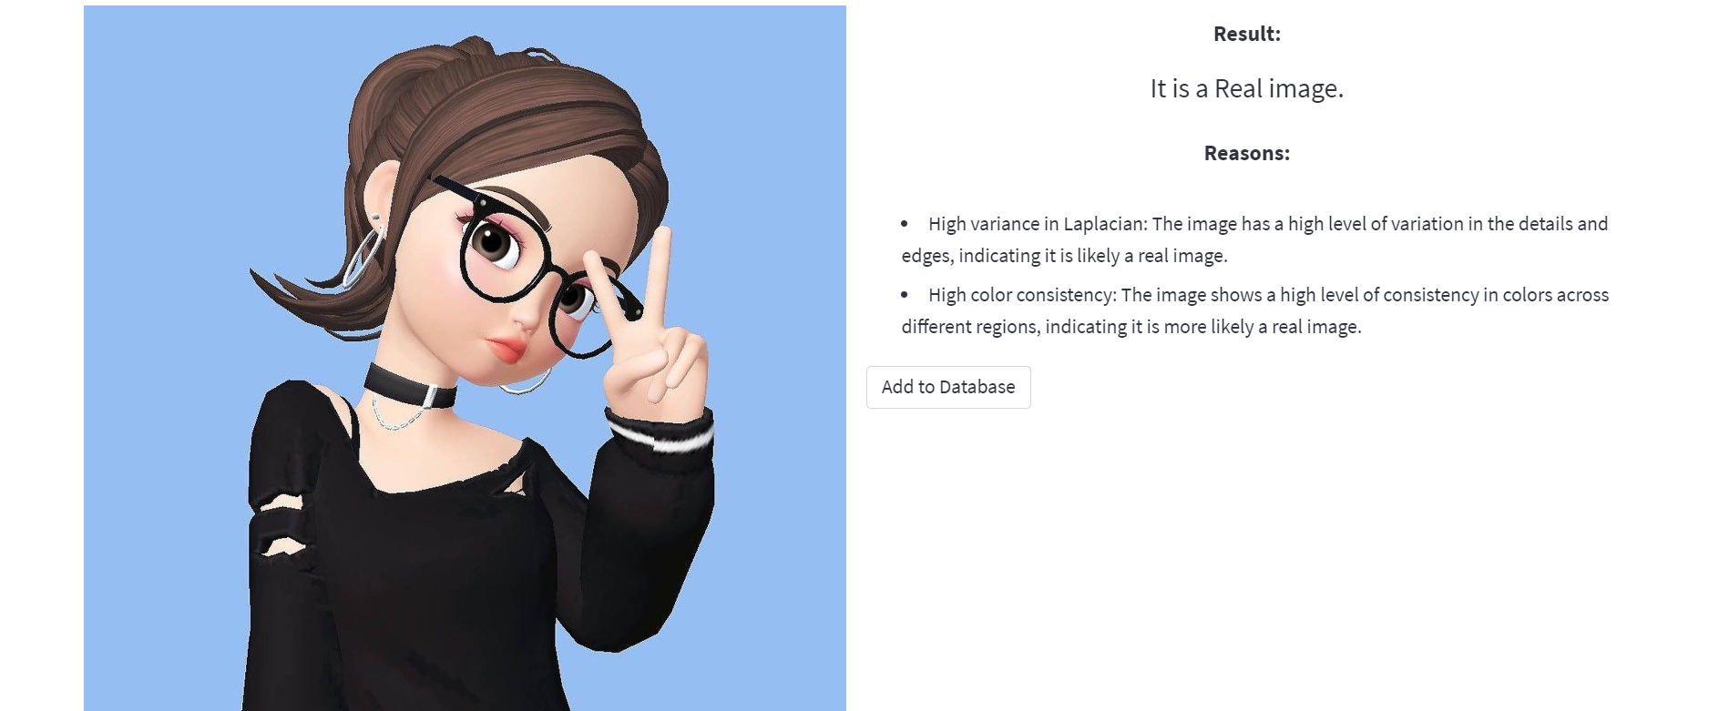
BEFORE DATA INSERTION

Slide 34
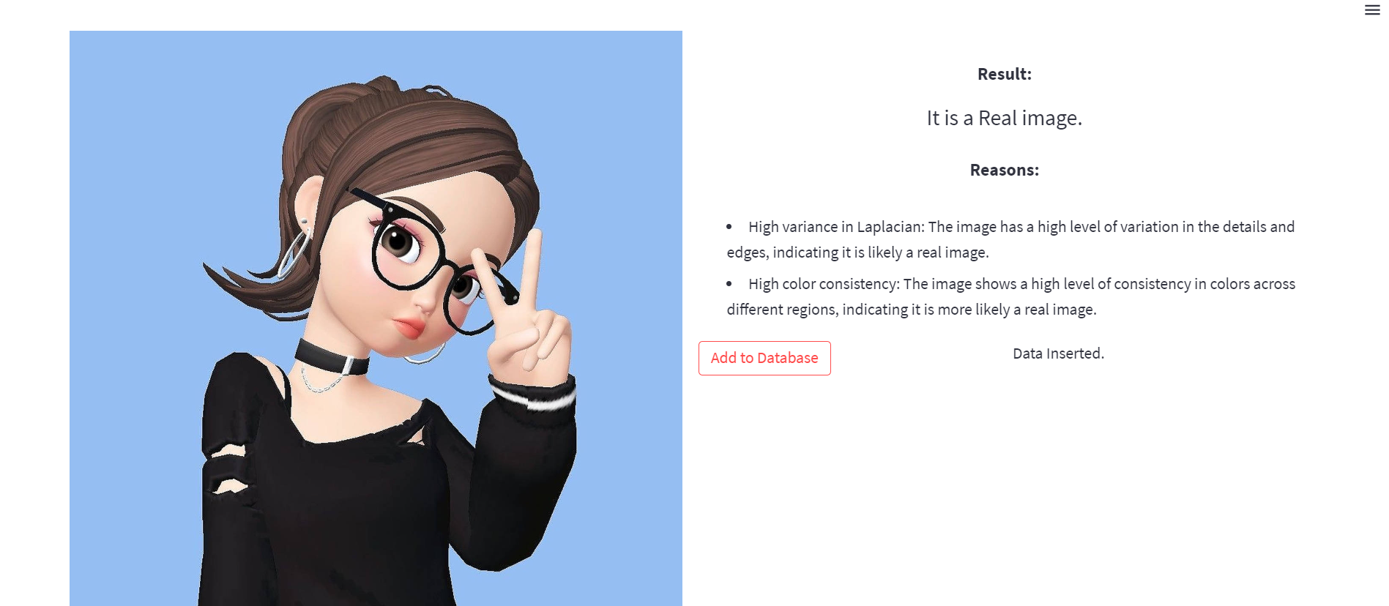
AFTER DATA INSERTION

Slide 35
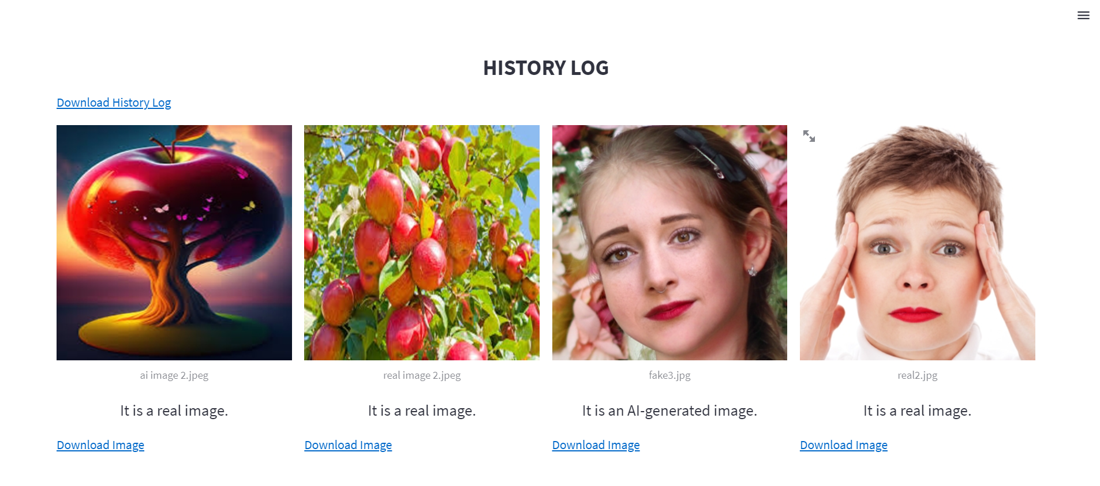
HISTORY LOG

Slide 36
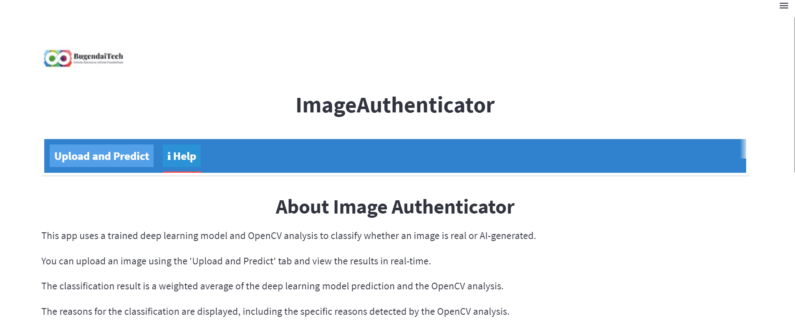
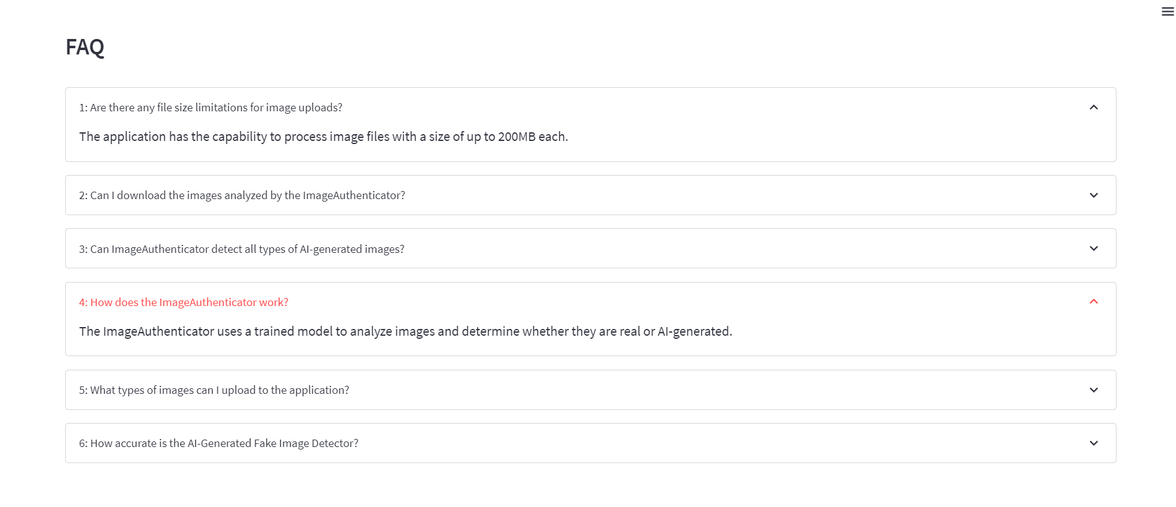
HELP

Slide 37
THANK YOU!

